Slide 1

CMSE 381: Fundamentals of Data Science Methods
Sep 1st, 2021

Slide 2
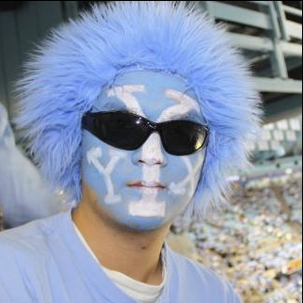
About me
谢於颖
YuYing Xie
Xie YuYing
XYY
Clark
Chr X Chr Y Y

Slide 3
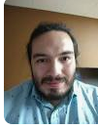
About TA: Luis Polancocontreras (polanco2@msu.edu)
Office Hours: 12-2 pm Friday

Slide 4
Introduce yourself.
What is the most boring thing you have done during the pandemic?

Slide 5
What is the course about?
Topics:
Fundamental concepts of data science
Regression
Classification
Dimension reduction
Resampling methods
Tree-based methods, etc.
Textbook:
An Introduction to Statistical Learning, with applications in R.
The Elements of Statistical Learning: Data Mining, Inference, and Prediction
Also have a youtube list

Slide 6
What is the course about?
Textbook:
An Introduction to Statistical Learning, with applications in R.
Online version available!
https://www.youtube.com/user/joshstarmer

Slide 7
Instruction Format
In Class:
Stop me if you have any question!
What happens in CMSE 381 stays in CMSE 381
Grade Breakdown:
30% for Homework
40% for Quizzes
40% for the Final Project

Slide 8
Homework Policies
Homework assigned every class day by 9: 00p.m., it is due before class on every the other Monday.
30% of final grade.
No late homework will be accepted (TA is full in charge).
Allowed to work with other students but homework should be in your own words.
Each homework carries equal weight.
Code needs to follow Google Style

Slide 9
Quiz Policies
There are four 30 minutes Quizzes during the semester.
The quiz questions will be based on homework problems and the examples given in classes.
40% of final grade.
There will be no make up quizzes
Quizzes will be given in class on the following days:
Sep 24th; Oct 15th; Nov 5th; Dec 10th
There will be some 3-minutes bonus-quizzes (1 credit) at the end of some classes. These credits can be added to your formal quiz but your total Quiz-score is topped by 4 * 50 = 200.

Slide 10
Fun Friday
Real data analysis
A group of three students
Present data structure, questions can be answered by the data, analyses, and results.
5 extra points towards your final project

Slide 11


Study Groups
https://discord.gg/SjFez692

Slide 12
Graduate School 1. Research experience 2. Letters 3. Fellowship (NSF) 4. Course work 5. Broader Impact Industrial 1. Research experience 2. Internship 3. Programming skill (Leetcode) 4. Letters
Make yourself different!

Slide 13
Guest lecture from Big-tech Companies

Slide 14
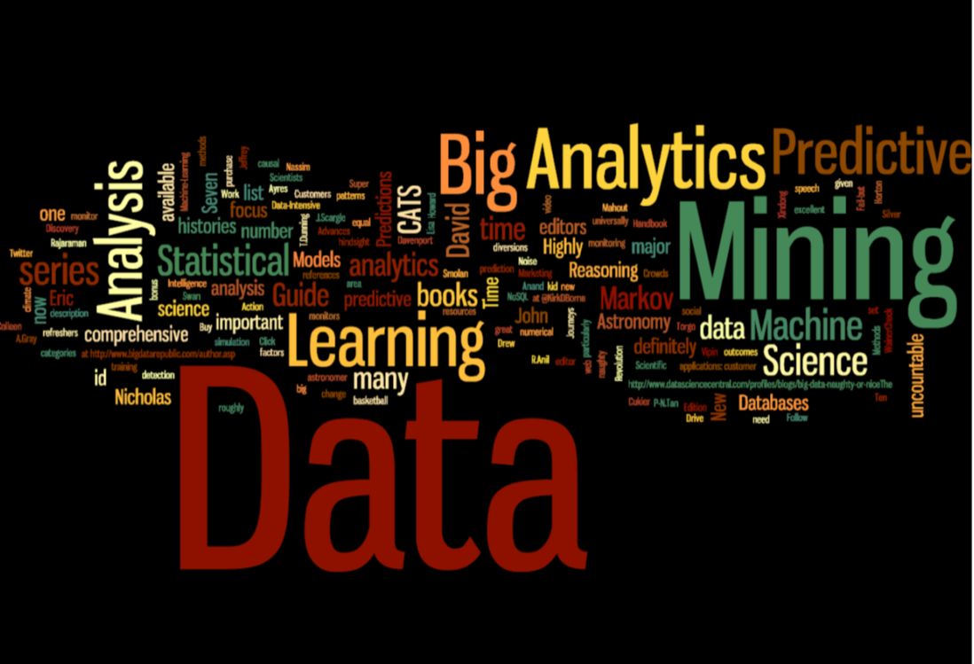
What is Machine Learning?
Arthur Samuel (1959, IBM): Field of study that gives computers the ability to learn without being explicitly programmed

Slide 15
What is Statistical Learning?
Subfield of Statistics
Statistical learning emphasizes models and their interpretability, and precision and uncertainty.
Machine learning has a greater emphasis on large scale applications and prediction accuracy.
The distinction between machine learning and statistical learning has become more and more blurred.

Slide 16
Why should you care?
Nowadays, data is cheap (or even free), learning how to analyze data is critical.
Web data, e-commerce (Amazon, JD, Alibaba)
Car sales (Tesla, Ford, and GM)
Sport team (MSU, Lions, etc)
Interpreting results and prevent any bad decisions.

Slide 17
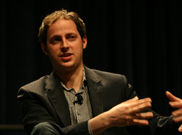
Example: Presidential election
http://fivethirtyeight.com/
On 2008, he correctly predicted the winner of 49 of the 50 states and all 35 U.S. Senate races .
On 2012, he correctly predicted the winner of all 50 states and the District of Columbia. That same year, Silver's predictions of U.S. Senate races were correct in 31 of 33 states.
All the data he used came from internet!
Dow down 313 points after Obama won
On 2016, oops…….

Slide 18
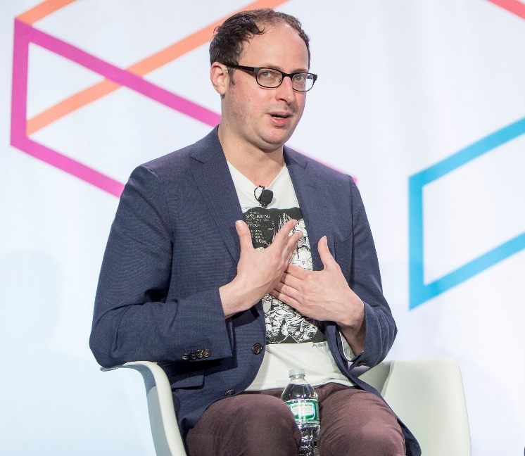
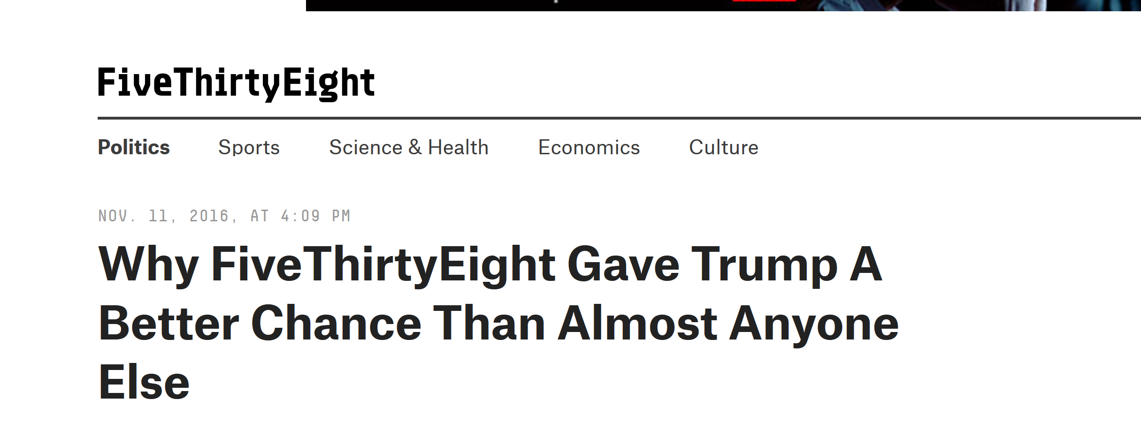
Example: Presidential election 2016

Slide 19
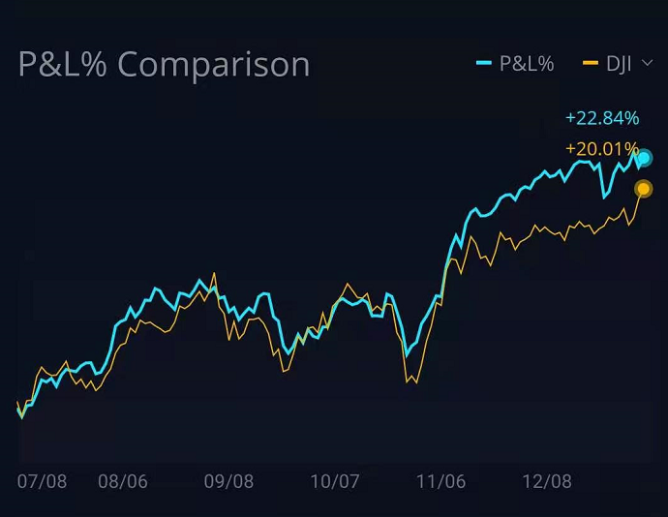
Example: Presidential election

Slide 20
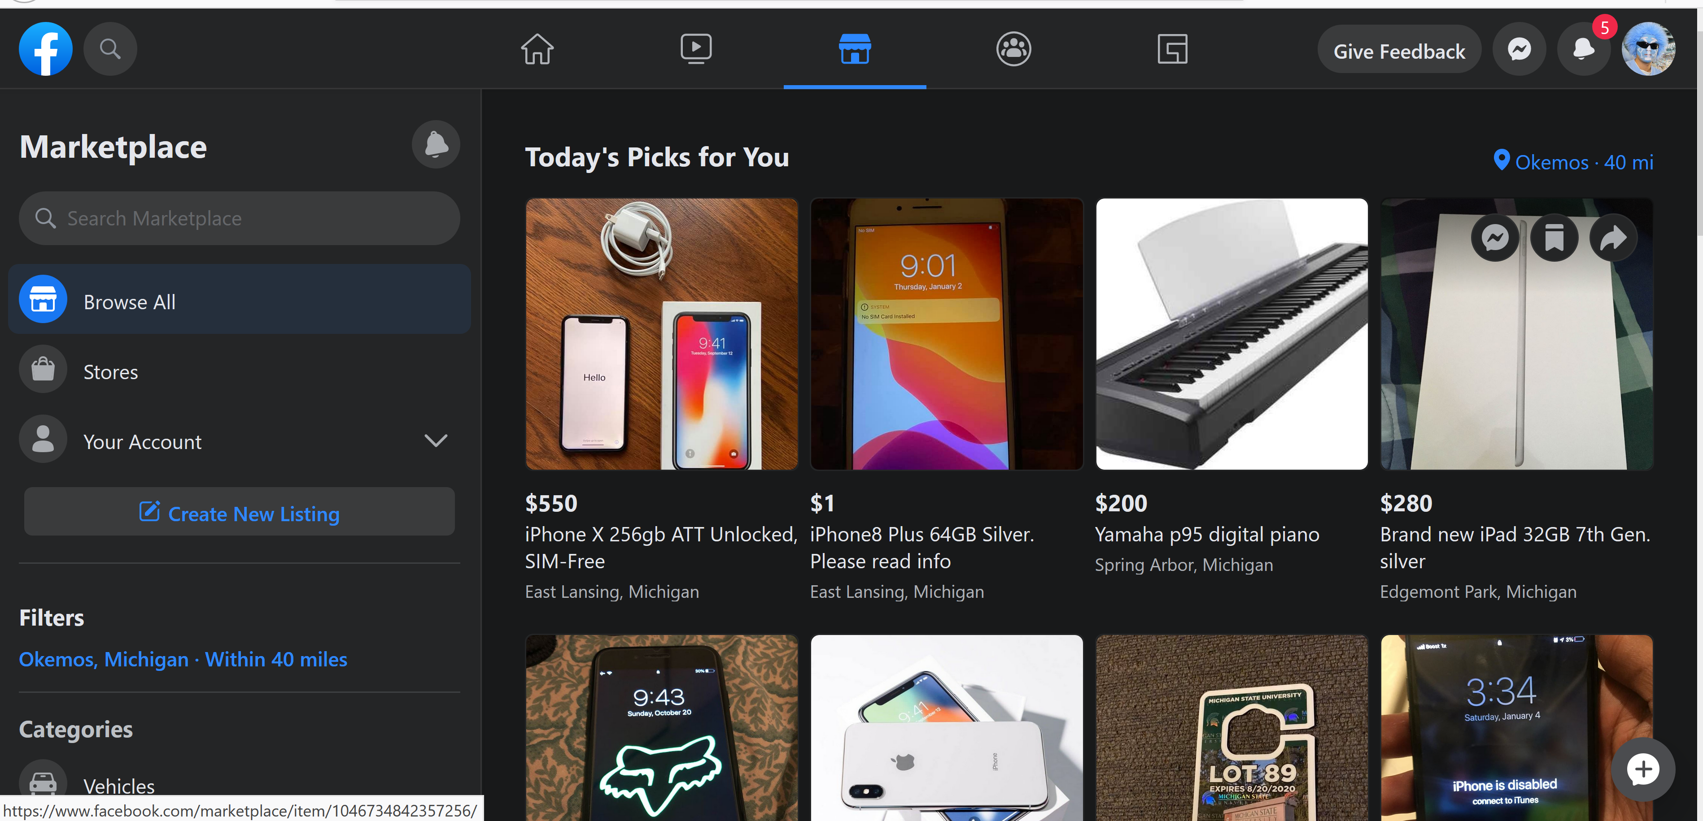
Example: Big Data

Slide 21
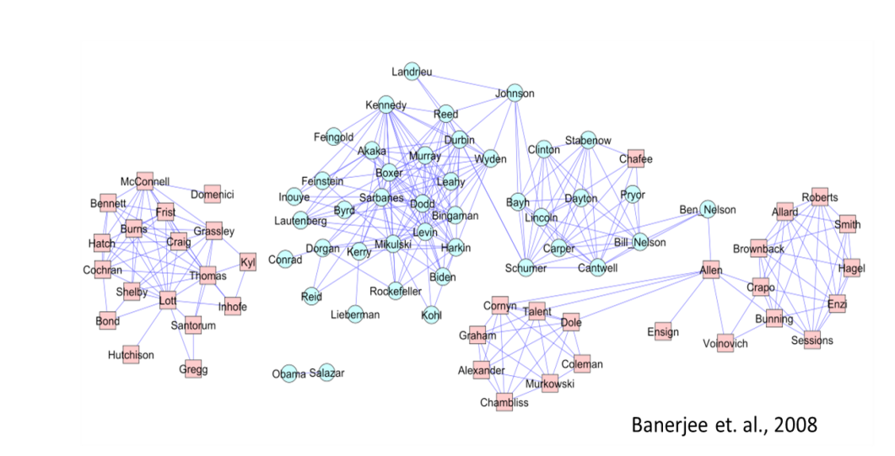
Politics

Slide 22
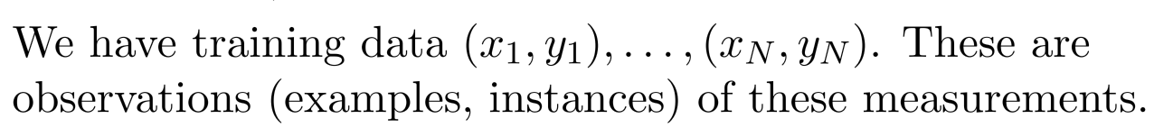
The Supervised Learning
Outcome measurement Y (also called dependent variable, response, target, label).
Vector of p predictor measurements X (also called inputs, regressors, covariates, features, independent variables).
In the regression problem, Y is quantitative (e.g price, blood pressure).
In the classiﬁcation problem, Y takes values in a ﬁnite, unordered set (survived/died, digit 0-9, cancer class of tissue sample).

Slide 23
Objectives
On the basis of the training data we want to?
Accurately predict unseen test cases.
Understand which inputs affect the outcome, and how.
Assess the quality of our predictions and inferences

Slide 24
Unsupervised Learning
No outcome variable, just a set of predictors (features) measured on a set of samples.
objective is fuzzier: ﬁnd groups of samples that behave similarly, ﬁnd features that behave similarly, ﬁnd linear combinations of features with the most variation.
diﬃcult to know how well you are are doing.
diﬀerent from supervised learning but can be useful as a pre-processing step for supervised learning.

Slide 26
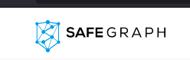
It obtains information related to customers via their mobile devices using 17 trillion location markers and various mobile applications that partner with SafeGraph.

Slide 27
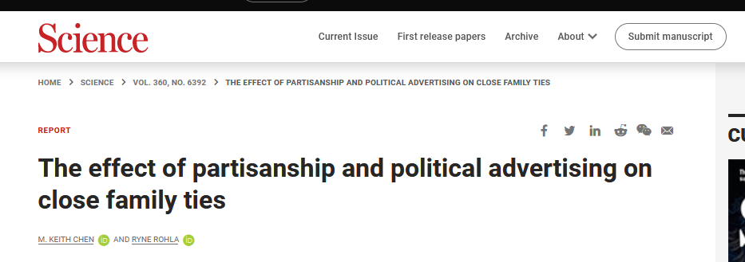
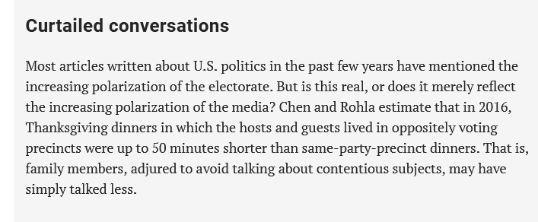

Slide 28
It obtains information related to customers via their mobile devices using 17 trillion location markers and various mobile applications that partner with SafeGraph.
How can you use this data?

Slide 29
Question

